Slide 1

Cronjobs in Linux

Slide 2

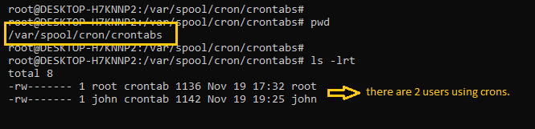
What is a cron?
Cron is a job scheduling utility present in Unix like systems. The crond daemon enables cron functionality and runs in background. The cron reads the crontab (cron tables) for running predefined scripts.
By using a specific syntax, you can configure a cron job to schedule scripts or other commands to run automatically.
For individual users, the cron service checks the following file: /var/spool/cron/crontabs

Slide 3
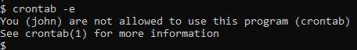
What are cron jobs in Linux?
Any task that you schedule through crons is called a cron job. Cron jobs help us automate our routine tasks, whether they're hourly, daily, monthly, or yearly.
How to Control Access to crons
In order to use cron jobs, an admin needs to allow cron jobs to be added for users in the '/etc/cron.allow' file.
If you get a prompt like this, it means you don't have permission to use cron.
To allow John to use crons, include his name in '/etc/cron.allow'. This will allow John to create and edit cron jobs.
Users can also be denied access to cron job access by entering their usernames in the file '/etc/cron.d/cron.deny'.

Slide 4
Cron job syntax
Crontabs use the following flags for adding and listing cron jobs.
crontab -e: edits crontab entries to add, delete, or edit cron jobs.
crontab -l: list all the cron jobs for the current user.
crontab -u username -l: list another user's crons.
crontab -u username -e: edit another user's crons.
When you list crons, you'll see something like this:
# Cron job example:
* * * * * sh /path/to/script.sh
In the above example,
* * * * * represents minute(s) hour(s) day(s) month(s) weekday(s), respectively.
ValueDescription
Minutes 0-59,Hours 0-23,Days 1-31,Months 1-12,Weekdays 0-6(Days of the week where commands would run. Here, 0 is Sunday.)
sh represents that the script is a bash script and should be run from /bin/bash.
/path/to/script.sh specifies the path to script.
Below is the summary of the cron job syntax.

Slide 5
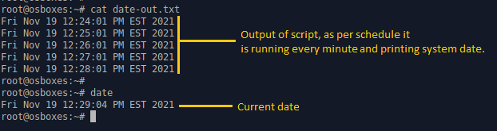
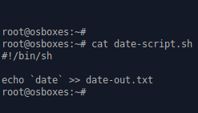
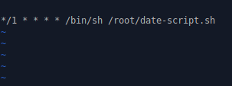
How to set up a cron job
In this section, we will look at an example of how to schedule a simple script with a cron job.
1.Create a script called date-script.sh which prints the system date and time and appends it to a file. The script is shown below:
Script for printing date.
2. Make the script executable by giving it execution rights.
chmod 775 date-script.sh
3. Add the script in the crontab using crontab -e.
Here, we have scheduled it to run per minute.
Adding a cron job in crontab every minute.
4. Check the output of the file date-out.txt. According to the script, the system date should be printed to this file every minute.

